Slide 1
Show/No-show Appointments
Asma Al Wazrah

Slide 2
TABLE OF CONTENTS
01
04
02
05
03
Introduction
Methodology
Question/need
Models Results
06
Discovering
Recommendation

Slide 3
INTRODUCTION
Missed outpatient appointments are a common problem for clinics, and reducing this rate improves office efficiency, income, and utilize the time to help other patients. The goal of this project is to better understand which factors are most important in missing appointments, and how those factors relate to show/no show rate

Slide 4
Question/need:
Which factors are most important in missing appointments
Did patients receive SMS prior appointment date?
Which model is the best to predict the show/no-show

Slide 5
Missed appointments once?
DISCOVERING
4.13%
Reservation rate
3.87%
64.99%%
35.01%%
Around 20.31% of females have missed their appointments compared to men (19.96%). Moreover, most reservations are from females (64.99%) which indicates a good health care from their side.
Around 4.03% of patients have missed their appointments twice or more.

Slide 6
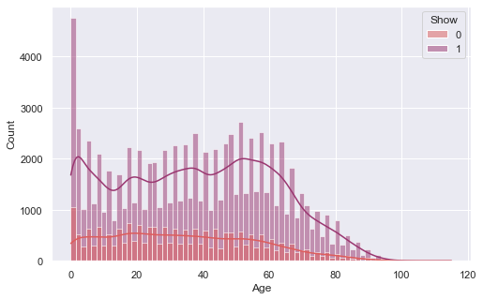
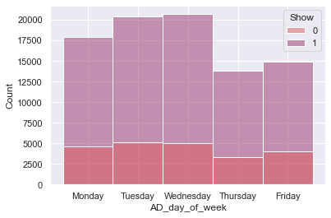
DISCOVERING
The majority of Shown patients are babies and elderly
low no. of patients on last 2 working days

Slide 7
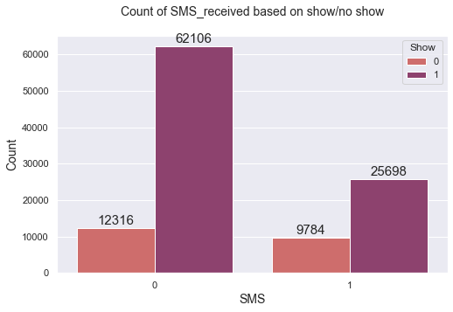
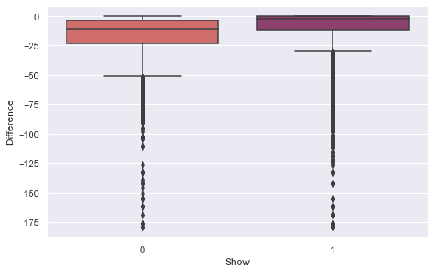
DISCOVERING
There are a reservations that exceed 5 months. the missing occurs if the difference between schedule and appointment dates increase
There were wrong dates (reservation date after appointment date (difference>0)), There are also reservations that exceed 5 months. the missing occurs if the difference between schedule and appointment dates increase

Slide 8
Methodology
DAY 1
DAY 2
DAY 3
DAY 4
DAY 5
Feature engineer
ML/DL models
1
2
3
4
Dataset
Best model
Preprocessing
Train/test split

Slide 9
Models Results
Accuracy | Precision | Recall | F1
79.43% | 79.76% | 99.39% | 88.50%
78.38% | 81.59% | 94.08% | 87.39%
79.70% | 80.48% | 98.38% | 88.53%
79.64% | 79.94% | 100.00% | 88.85%
Logistic Regression
Random Forest
XGBoost
Deep NN

Slide 10
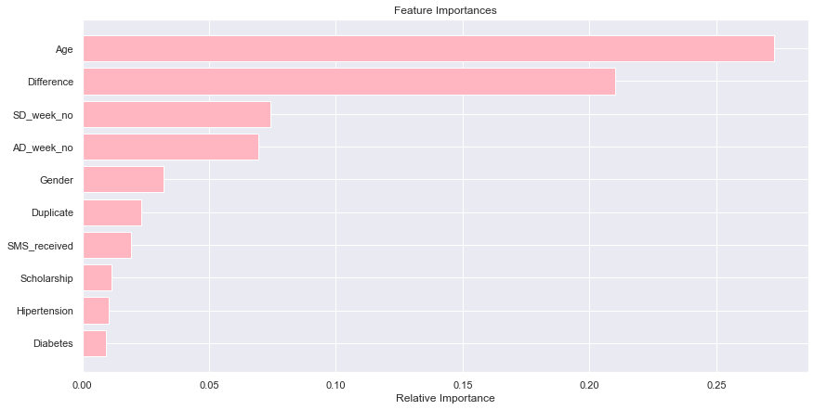
Models Results
00.26%
20.09%
00.48%
79.16%
CONFUSION MATRIX (LR)
FEATURE IMPORTANCE (RF)

Slide 11
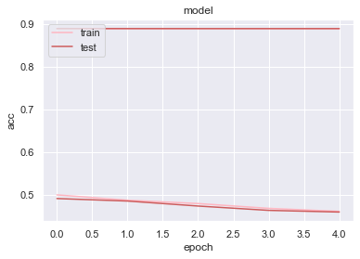
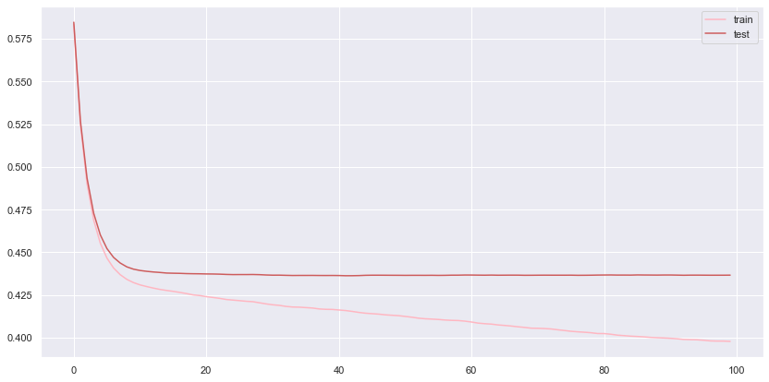
Models Results
F1
loss
F1 & loss (DNN)
Train vs Test (XGBoost)

Slide 12
Recommendation
“Lets give the priority to the children and elderly for appointment schedule!”
“Let’s increase the appointments’ slots, maximum 20 days between the schedle date and appointment date”
“Let’s use phone call to ensure that the patient will attend one day prior the appointment date”

Slide 13
CONCLUSIONS
CONCLUSIONS
Age and difference are the most important features for prediction
Deep NN acheived the highest F1 score result
Recommendations for better healthcare service

Slide 14
THANKS

